Slide 1
TOOL
Unpacking your Attributed Population

Slide 2
NOTES FOR ONTARIO HEALTH TEAMS
Relevant for teams in:
Every resident of Ontario is attributed to an Ontario Health Team (OHT) based on the Physician Network methodology. The Physician Network methodology is a way of linking patients to a single usual care provider, and then assigning a provider’s patients to a network based on previous utilization patterns.
The Unpacking your Attributed Population Tool helps OHTs to better understand who is in their population, and how their attributed population (based on Physician Networks) relates to their geographical population.
When building your application, consider with your team…
Has our OHT engaged with all the physicians and associated organizations attributed to us through this methodology? Are there new partnerships we should seek out?
How does our attributed population compare to our geographic population? What nuances like travel time across our OHT should we be aware of when designing new initiatives and services?
Does the model address the needs of our target sub-population(s)? For instance, how do we address equity considerations like the needs of uninsured patients (e.g. newcomers, people with no fixed address, etc.) not currently included in the model?
Application Stages
Connecting to RISE:
Building Block 1: Defined patient population (Domain 1 – Target-population definitions)

Slide 3
IN A NUTSHELL
It’s natural to think about populations geographically. In Ontario, we have traditionally used geography to plan health services. But geography doesn’t always reflect how patients access care. Physician Networks take this behaviour into account and are centred around natural linkages between patients, providers, and health services. This methodology has been used to attribute patients to each OHT. It’s important for OHTs to understand all of the patients they are serving – both their attributed and geographical populations.
What does this tool help you do?
This tool allows you to visualize the population attributed to your OHT and how it relates to your geographical population. This includes permanent residents, the population flowing into your OHT, and the population flowing out (to other OHTs).

Slide 4
ABOUT THIS TOOL
What was the tool developed for?
Health Commons partnered with an Ontario Health Team to conduct a population health assessment, which included helping them to better understand how their attributed population relates to their geographical population and the implications for the OHT context.
How did we use it?
We developed a visual representation of the OHT’s attributed and geographical populations, including implications for their local context like seasonality. Based on this visual, we created a fillable tool that OHTs can complete to get a better understanding of their own populations.

Slide 5
HOW YOU CAN USE THIS TOOL
Use the template provided to fill in the population numbers for your OHT.
Think about your local context: Is there anyone else to consider who may or may not be attributed to your OHT?
Bring the completed visual to your next OHT planning meeting to start a discussion about the needs of those you are serving.

Slide 6
IN THIS SECTION
1
Understanding the Physician Network attribution methodology
Thinking about your attributed population in relation to your geography (example)
Thinking about your attributed population in relation to your geography (template)
Getting the population numbers to plug in
2
3
4

Slide 7
Every resident of Ontario is attributed to an Ontario Health Team based on the Physician Network methodology
Patient to Provider
USUAL PROVIDER OF CARE
Provider to Hospital
PATIENT
HOSPITAL
Linked to either a:
PC physician through rostering; or
physician who provided most of the core primary care services; or
physician who provided the greatest number of ambulatory services in the last 3 years
PC physicians linked to the hospital where most of their patients were admitted.
Specialists with inpatient work linked with the acute care hospital where they provided the most inpatient services.
Developed by Health Commons based on Stukel, Therese A., et al. "Multispecialty physician networks in Ontario." Open Medicine 7.2 (2013): e40.

Slide 8
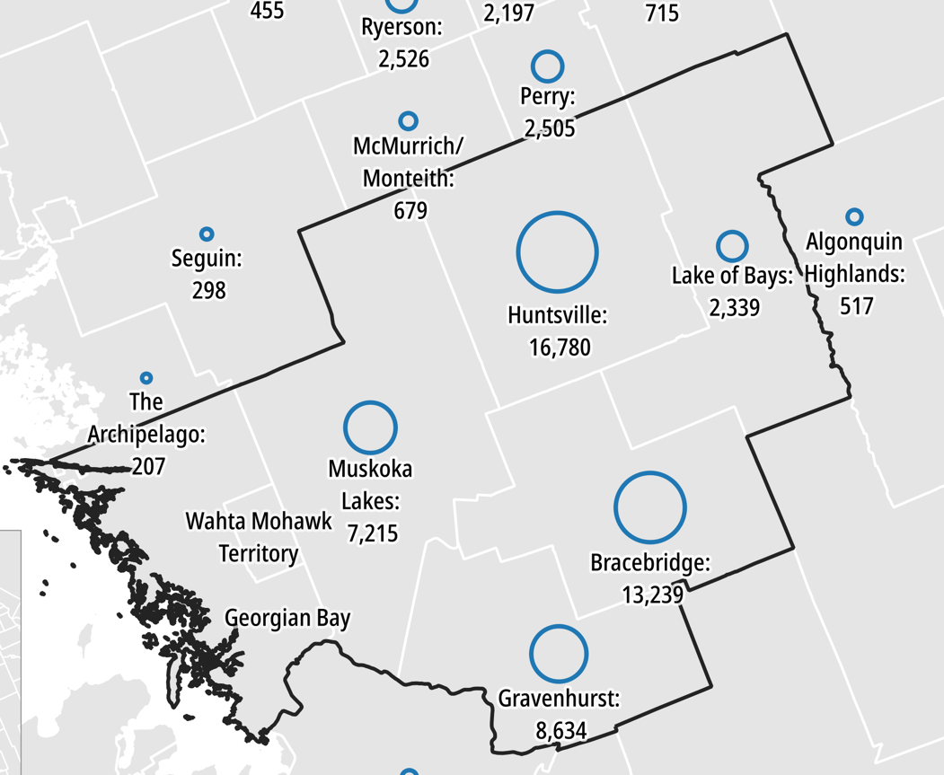
Muskoka and area OHT example of how the attributed population relates to geography
N = 48,207
PERMANENT RESIDENTS: Patients who live in Muskoka and Areas and are attributed to MAOHT
ATTRIBUTED ELSEWHERE: Patients who live in Muskoka and Areas but are attributed elsewhere (nearby OHTs).
N = Requested from Ministry
INFLOW: Patients who live outside Muskoka and Areas but are attributed to MAOHT (primary care provided in Muskoka)
SEASONAL: residents + visitors who use health care resources but are attributed elsewhere
For example, in Gravenhurst 8,634 patients were attributed to MAOHT representing ~70% of the city’s total population of 12,311 residents.
N = 16,238
N = Estimated 81,907
Map created by Health Commons Solutions Lab. Data from Ministry of Health (2017/18). OHT Data Package. [Attributed population].

Slide 9
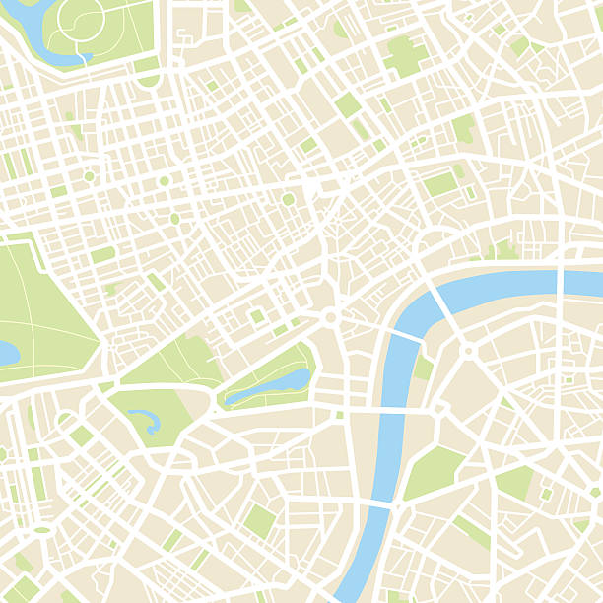
Here’s how to think about your attributed population in relation to your geography
Other populations to consider who may not be attributed to you…
PERMANENT RESIDENTS:
N = [#1]
Patients who live in your catchment and are attributed to your OHT
DAY-TIME VISITORS: N = [#4]
Patients who access services close to where they work
INFLOW:
N = [#2] Patients who live outside your community but are attributed to your OHT (likely because that is where they access primary care)
ATTRIBUTED ELSEWHERE: N = [#3]
Patients who live in your catchment but are attributed elsewhere (such as nearby OHTs)
SEASONAL: N = [#5]
Patients who use health care resources locally on a seasonal basis
NOT COVERED: N = [#6]
Patients who are not covered by OHIP such as newcomers
NO FIXED ADDRESS: N = [#7]
Patients who do not consistently use a health card and who may be experiencing homelessness

Slide 10
Here’s how to get the population numbers to plug in
Permanent Residents #1: Provided by the Ministry of Health, Health Analytics and Insights Branch (‘Ontario Health Team Population and Performance Indicators’) on the ‘Population overview’ tab. Under the heading ‘Where does the OHT attributed population live?’ select the community (or communities) that you identify as being part of ‘your geography’. For example, Muskoka and Area OHT considered their previous sub-LHIN boundary as their geography.
Inflow #2: Take the total number of patients attributed to your OHT and subtract the number identified as part of #1.
Attributed Elsewhere #3: This information is a not listed in the Ministry data package but can be requested. Another option to approximate the number of people in this category is to take the Census population estimate for ‘your geography’ and compare it to the number of individuals attributed to you as identified in #1. Note that caution should be used when comparing population estimates from the Census and health administrative databases as the population definition is not consistent.
Day-time Visitors #4: This is most relevant in large urban areas where there is a large commuter population.
Seasonal #5: This can include temporary seasonal workers, seasonal visitors or occasional residents. Often cities or municipalities provide estimates for these population groups on their website.
Not Covered by OHIP #6: This population can be difficult to quantify. Check your city/municipality for estimates of the population size. Check your city/municipality for estimates of the population size. Your local partners at Community Health Centres, community service organizations, public health units, and not-for-profits may also be able to help.
No Fixed Address #7: This population can be difficult to quantify. Check your city/municipality for estimates of the population size. Your local partners at Community Health Centres, community service organizations, public health units, and not-for-profits may also be able to help.

