Slide 1
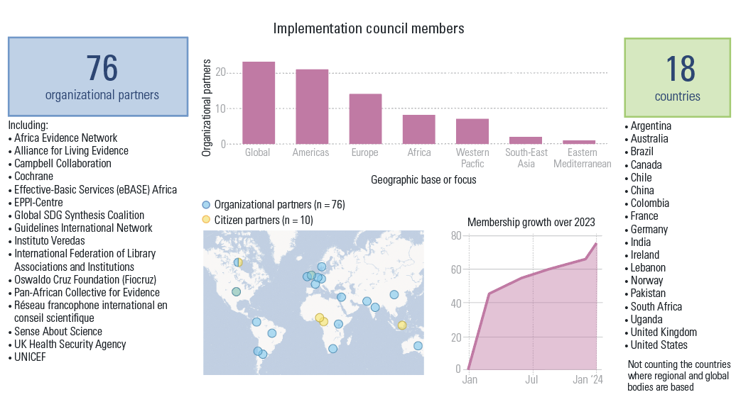
Our Implementation Council is now 76 organizational partners strong, and drawn from 18 countries in every part of the world and from many global and regional bodies

