Slide 1
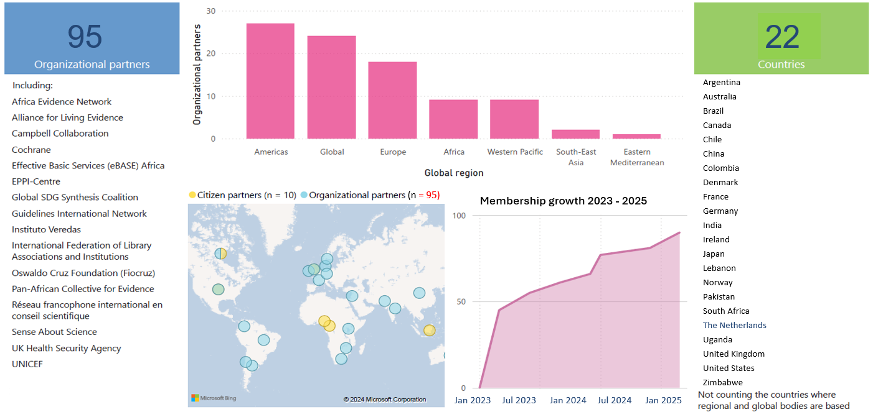
Our Implementation Council will conclude its work 95 organizational partners strong, and drawn from 22 countries in every part of the world and from many global and regional bodies

