Slide 1


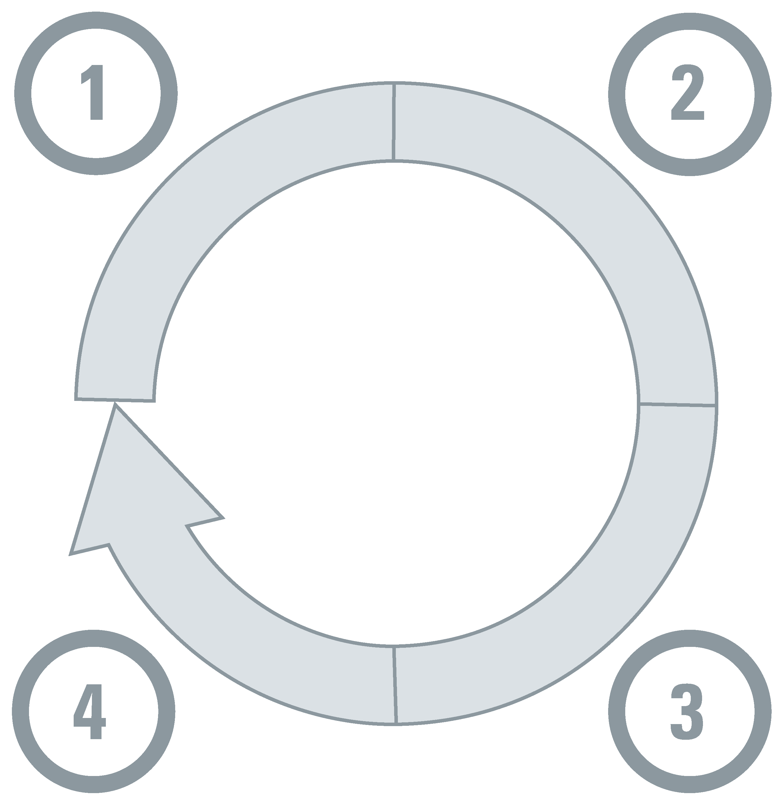












Those supporting government policymakers will now be able to access global evidence and then very rapidly provide highly contextualized insights from the global evidence alongside insights from what has been learned from national (and local) evidence
Domestic evidence
Global evidence
Other types of information
(by step in the decision-making cycle,
any of which could be the focus of a contextualized evidence synthesis)
(each for one or more steps in the decision-making cycle)
Understanding a problem and its causes
Selecting an option for addressing the problem
Evidence synthesis,
Ideally living
(what has been learned from around the world, including how it varies by groups and contexts)
Jurisdictional scan
(to document policies and practices
and experiences with & evaluations of what’s been tried in parts of the country and in other countries)
 | Data analytics
 | Modeling
 | Qualitative insights
 | Modeling
 | Evaluation
 | Qualitative insights
 | Guidelines
 | Technology assessments
Horizon scan
(to leverage foresight work done nationally and globally)
Emerging evidence
(what is being learned from around the world as the evidence evolves rapidly)
Key-informant interviews summary (to leverage rich experiences) and public-opinion research (to capture opinions)
Monitoring implementation and evaluating impacts
Identifying implementation considerations
Deliberative processes summary (to engage citizens and stakeholders in collective problem solving) and stakeholder engagement more generally
 | Data analytics
 | Evaluation
 | Qualitative insights
 | Behavioural/ implementation research
 | Qualitative insights

