Slide 1
Timely demand-driven evidence-support units operating within national (and local) evidence-support systems will now be able to leverage the actionable insights, living evidence syntheses, and supporting infrastructure made possible through ESIC
Structures and processes on the evidence-demand side to: 1) incorporate evidence into routine advisory and decision-making processes and into learning and improvement platforms (enablers) 2) build and sustain an evidence culture; 3) strengthen capacity for evidence use
Evidence-demand prioritization mechanism (horizon scanning and elicitation of questions)
One-window requests (when complex questions) | Packaged responses that align with decision-making processes
Evidence-supply coordination mechanism (ultra-rapid evidence support to bring in needed forms of existing evidence and a ‘general contractor’ model to bring in the right ‘trades’ to build out new evidence)
Timely demand-driven evidence-support units (the ‘trades’) … focused on a specific form of evidence
Data analytics Modeling Evaluation Behavioural/implementation research Qualitative insights | Evidence synthesis (contextualized) Technology assessments / cost-effectiveness analysis Guidance
… focused on specific sectors (and many forms of evidence) Climate action Education, health, public security, social services, etc. International development
Evidence Synthesis Infrastructure Collaborative Actionable insights Living evidence syntheses Infrastructure supporting demand-side engagement, data sharing & reusing, AI use, methods innovation, and capacity sharing

Slide 2


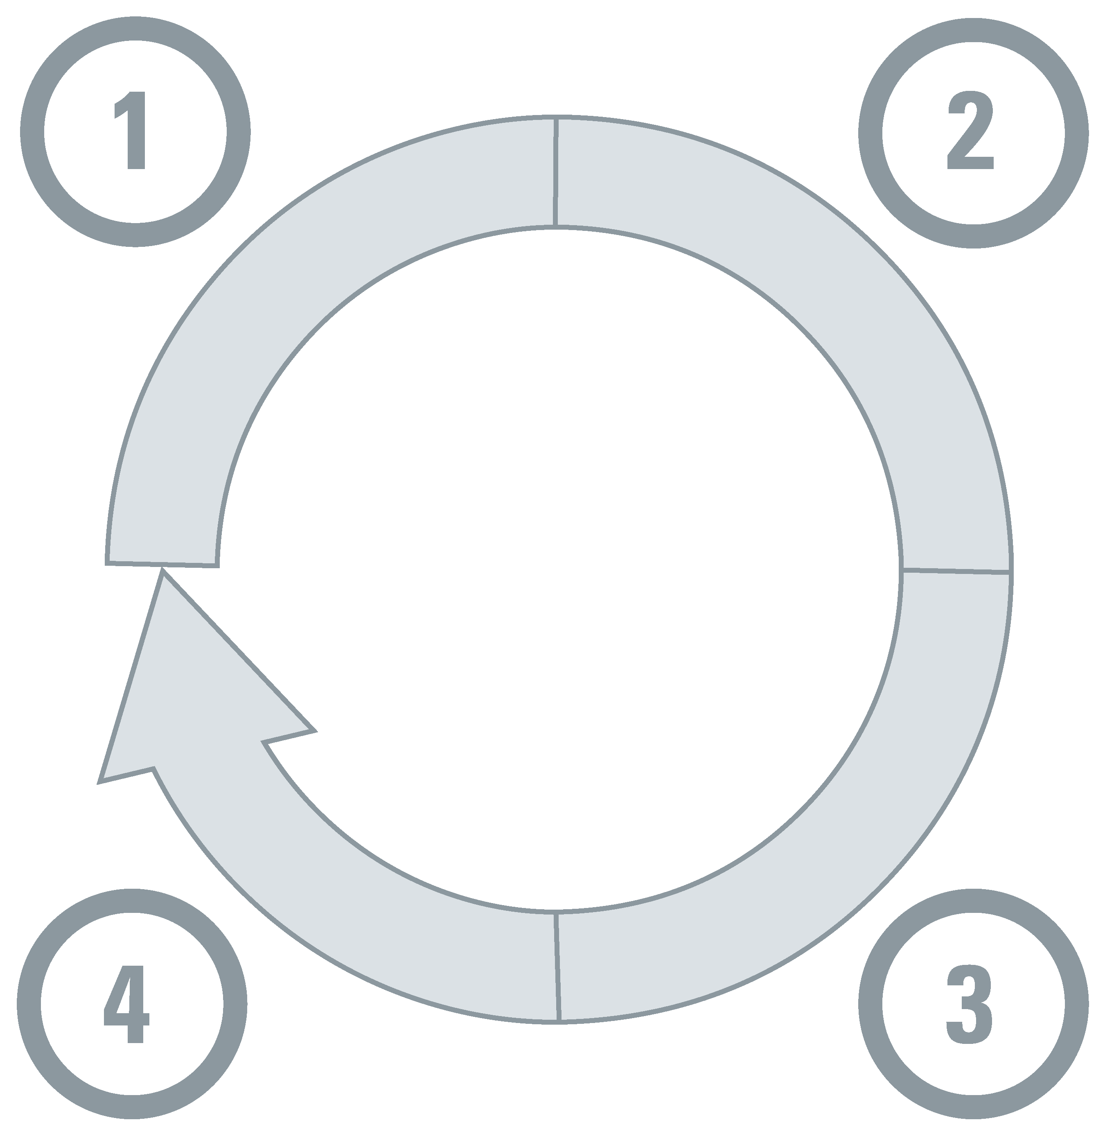












Those supporting government policymakers will now be able to access global evidence and then very rapidly provide highly contextualized insights from the global evidence alongside insights from what has been learned from national (and local) evidence
Domestic evidence
Global evidence
Other types of information
(by step in the decision-making cycle,
any of which could be the focus of a contextualized evidence synthesis)
(each for one or more steps in the decision-making cycle)
Understanding a problem and its causes
Selecting an option for addressing the problem
Evidence synthesis,
Ideally living
(what has been learned from around the world, including how it varies by groups and contexts)
Jurisdictional scan
(to document policies and practices
and experiences with & evaluations of what’s been tried in parts of the country and in other countries)
 | Data analytics
 | Modeling
 | Qualitative insights
 | Modeling
 | Evaluation
 | Qualitative insights
 | Guidelines
 | Technology assessments
Horizon scan
(to leverage foresight work done nationally and globally)
Emerging evidence
(what is being learned from around the world as the evidence evolves rapidly)
Key-informant interviews summary (to leverage rich experiences) and public-opinion research (to capture opinions)
Monitoring implementation and evaluating impacts
Identifying implementation considerations
Deliberative processes summary (to engage citizens and stakeholders in collective problem solving) and stakeholder engagement more generally
 | Data analytics
 | Evaluation
 | Qualitative insights
 | Behavioural/ implementation research
 | Qualitative insights

Slide 3
Signs of building momentum with implementation priority 1 are still there,
but we’re not seeing commitments to formalize and strengthen national (and local) evidence-support systems
1a
Era of fast-moving ‘polycrises’ and rapidly developing AI mean evidence support is needed now more than ever
Pilots of ultra-rapid evidence support and a ‘general contractor’ model are demonstrating value for money and building demand
Evidence-support mechanisms increasingly aligned both ‘up’ to advisory and decision-making processes and ‘out’ to learning and improvement platforms
Cross-country evidence-support collaborations are emerging in key sectors like education, development and health
Collaborations across forms of evidence are also emerging, such as with evaluation and evidence syntheses
Rapid evidence-support system assessments are pointing us towards the fertile ground where we need to ‘plant more seeds’
1b
1c
1d
1e
1f

Slide 4
Some of the signs of building momentum with implementation priority 3 are still there, but we’re not seeing commitments to truly put evidence at the centre of everyday life
3a
Partners are coming together to learn from one another (e.g., Cochrane- GCESC-WHO EVIPNet webinar series; space is being co-created for discussions about Indigenous rights and ways of knowing)
Greater acknowledgement that citizens are inundated with information, misinformation and disinformation, and more commitment to finding effective ways to counter mis/disinformation
More appreciation for the strong headwinds and for the need to ‘lock arms’ to make progress against these headwinds
Greater recognition that we need to use a collective-impact orientation
3b
3c
3d

